Slide 1
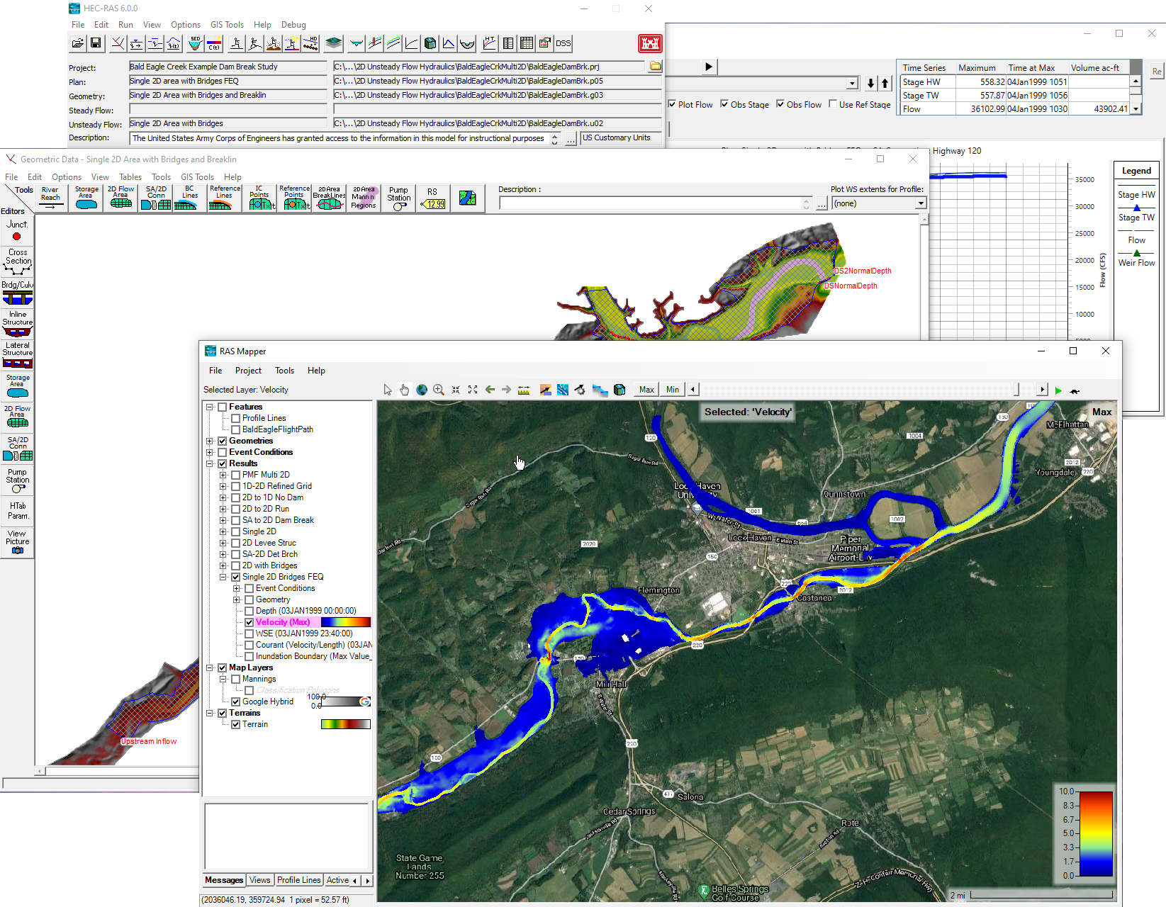
HEC-RAS
Giulia Sofia, PhD

Slide 2
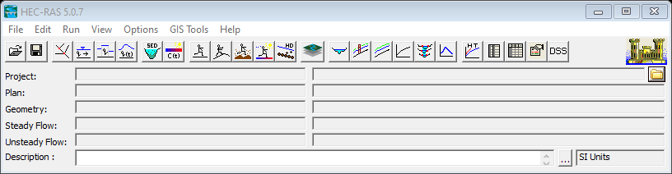
Overview
HEC-River Analysis System is a software for river hydraulic evaluations:
Steady flow profiles
Unsteady flow simulations (both 1D along rivers or channels and 2D floods over plains)
1D Sediment analysis and stable channel evaluations
1D water quality analysis

Slide 3
Overview
The most comprehensive and up to date reference is available under the help menu. Please refer to
the hydraulic reference for the basic theory and to know how the hydraulic theory is applied as a numerical method
the User Manual to understand the program structure and the meaning of the various screens

Slide 4
Main references
HEC-RAS User's Manual. US Army Corps of Engineers
https://www.hec.usace.army.mil/confluence/rasdocs/rasum/latest
HEC-RAS Hydraulic Reference Manual 2020
https://www.hec.usace.army.mil/confluence/rasdocs/ras1dtechref/latest
HEC-RAS Documentation. US Army Corps of Engineers.
https://www.hec.usace.army.mil/confluence/rasdocs
HEC-RAS Mapper User’s Manual
https://www.hec.usace.army.mil/confluence/rasdocs/rmum/latest
HEC-RAS 2D User's Manual. US Army Corps of Engineers
https://www.hec.usace.army.mil/confluence/rasdocs/r2dum/latest

Slide 5
Overview
RAS Mapper
Open and save the project
Open the geometry editor
Open graphical results
Open tabular results and notes
Open the steady flow editor
Open the unsteady flow editor
Open the steady plan editor
Open the unsteady plan editor

Slide 6
Overview
A single HEC-RAS project works in a dedicated folder you set at start.
RAS saves a lot of working file. The main ones are the following:
the project file .prj
contains the summary of all the project
the geometry files .gxx (.g01, .g02, etc)
contain the geometric and topographic data (perhaps in the up to date and the design scenarios)
the unsteady flow files .uxx
contain the initial and boundary condition data for an unsteady flow analysis
The plan files .pxx
contain the information needed for a simulation, that is a geometry reference, a boundary condition reference and other simulation parameters (tolerances, settings, time steps, etc)

Slide 7
A RAS project
RAS project
Area1 geometry (g01)
Event 1 (p01)
Unsteady flows condition (u01)
Area2 geometry (g02)
Event 1 (p02)
TR 50y unsteady flow (u02)
Area 3 geometry (g03)
Design TR 50y unsteady analysis (p03)
2022 flood flow (u03)
Area 3 unsteady analysis (p04)

Slide 8
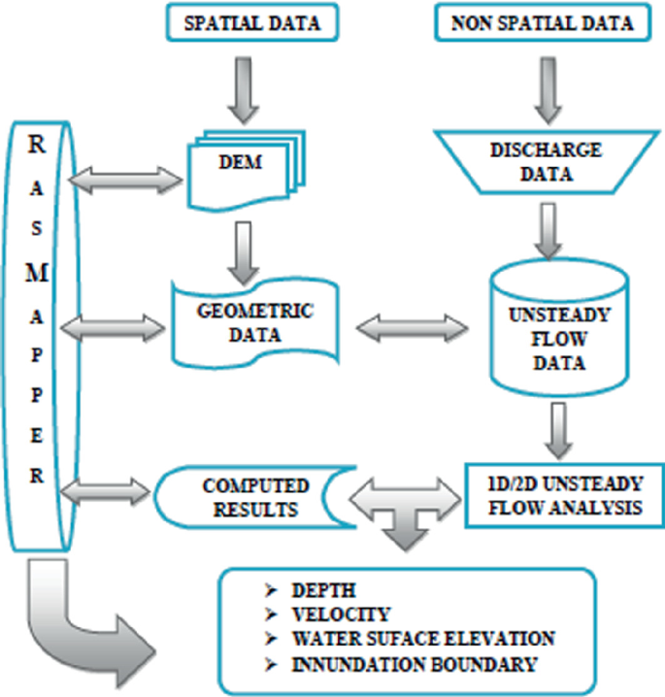
A RAS project
The needed information is stored in specific files within the working folder
Pallavi, H., Ravikumar, A.S. (2022)

Slide 9
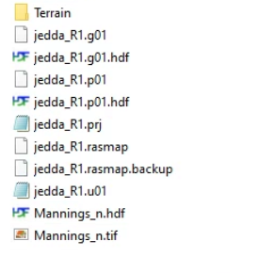
For Windows
A single HEC-RAS project works in a dedicated folder.
Terrain data [as *.HDF file]
Geometry data *.g01
Plan data *.p01
*.p01.HDF
Results from RASMAPPER
Unsteady flow file
Mannings’ file

Slide 10
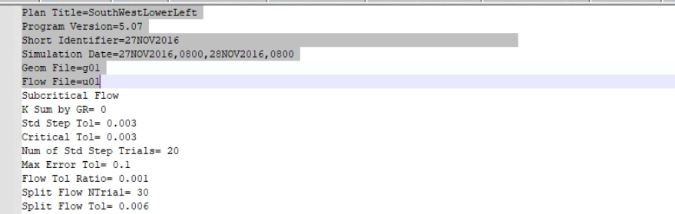
Plan data
Plan data *.p01
It is a simple text file, that contains [amongst others]
the plan name,
The simulation window
the flow and geometry file used by the project

Slide 11
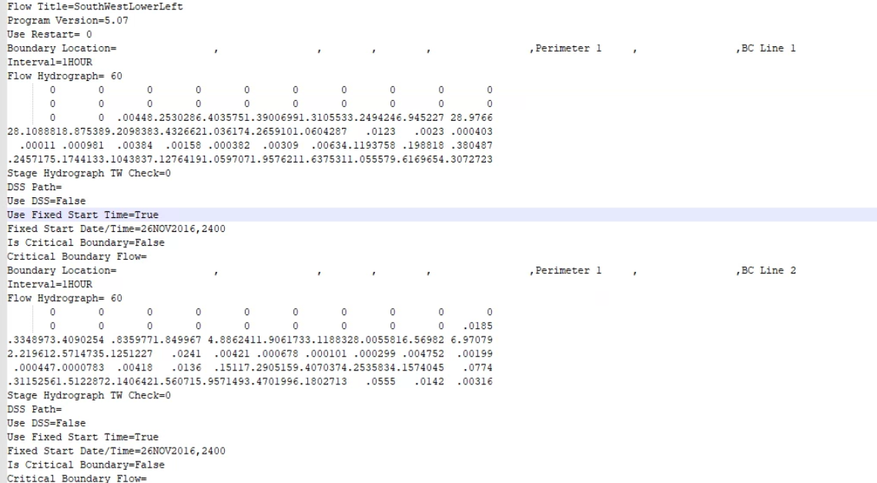
Unsteady flow file
Unsteady flow file *.u01
It is created AFTER the input hydrographs are set in the program.
For each boundary condition, it includes
- the name,
the computational interval,
The flow hydrographs values
The beginning of the event

Slide 12

From windows to linux
List of the files used by HEC-Ras
Extension | Description | Windows | Processed in NCM | Input for Linux
.prj | project file
.p01 | plan files
.g01 | geometry files
.u01 | unsteady flow files
.b01 | unsteady run files
.x01 | input file for geometry preprocessor
.O01 | binary output file
.bco | model log file
.c01 | output of geometry preprocessor
.dss | input / output files

Slide 13
For Linux
Files needed from HEC-RAS GUI run
The HEC-RAS GUI will need to be run to provide a base set of the input files for the Linux compute.
Geometry based files
*.c01
*.x01
Text based files will need to have the ending carriage return character stripped to be Linux compatible (.x04 and b04).
*.g01.hdf
*.b01
*.p01.tmp.hdf
*.p01.hdf

Slide 14
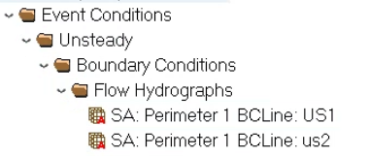
For Linux
Unsteady flow *.u01
not needed. The linux version reads the input flows from the *.p01.hdf file.
The NCM system has a series of python routines that read the CREST results, and embed them into the original HDF file at each run.

Slide 15
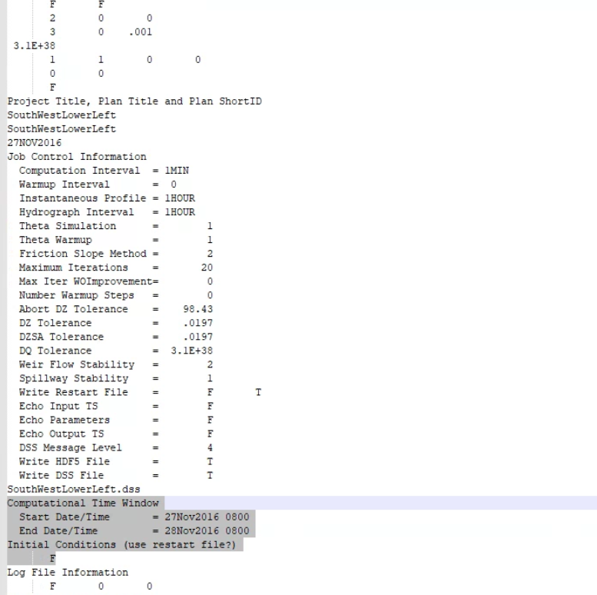
For Linux
Unsteady flow *.b01
This file is created at the first run in windows, and it MUST exist for the linux version to run
Importantly, this file contains
- The calibration parameters
- the computational window for each run
The NCM system has a series of python routines that read the CREST results, and embed the beginning and end into the file
Nda: Initial restart must be set to F [False]

Slide 16
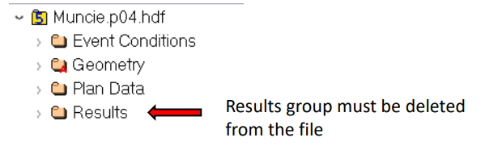
For Linux
*.p01.temp.hdf
The *.p01.tmp.hdf is derived from an HEC-RAS GUI compute that produces the file *.p01.hdf.
The computed file includes the event conditions, the plan and geometry data, and the results.
In windows, the software ‘transforms’ the p01.hdf file into a file named *.p01.tmp.hdf. This step does not exist in the linux version. Nonetheless, the software needs such file to run.
The *.p01.hdf cannot simply be renamed to *.p01.tmp.hdf
The NCM system has a series of python routines that read the p01.hdf file, and remove the results from any previous run.

Slide 17
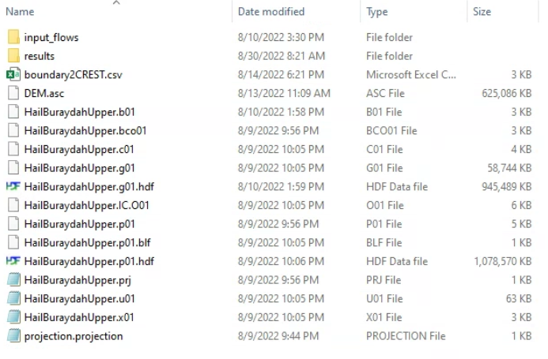
Structure of each folder for NCM
Folders where flows and results are stored
List of correspondence between outlet names from CREST, and HECRAS boundary condition names
Terrain data as *.ASC file
Coordinate system of the project

Slide 18
Questions?

